Slide 1
Bayesian Statistics
WinBUGS/ DoodleBUGS
Brani Vidakovic
Professor
School of Industrial and Systems Engineering
Creating a Doodle
Running Doodleplot

Slide 2


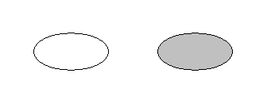
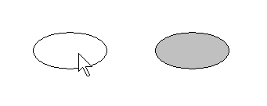
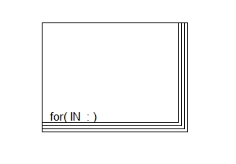

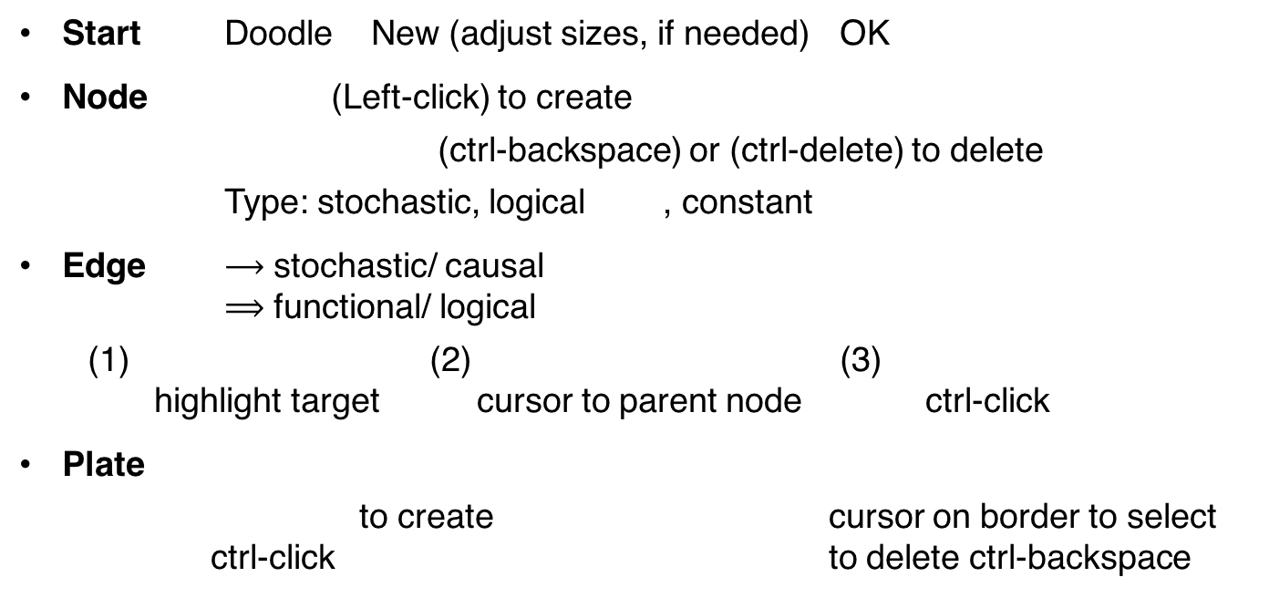


DoodleBUGS
Start Doodle New (adjust sizes, if needed) OK
Node (Left-click) to create
(ctrl-backspace) or (ctrl-delete) to delete
Type: stochastic, logical , constant
Edge $⟶$ stochastic/ causal
$⟹$ functional/ logical
(1) (2) (3)
highlight target cursor to parent node ctrl-click
Plate
to create cursor on border to select
ctrl-click to delete ctrl-backspace
$$⟵$$
$$←$$

Slide 3
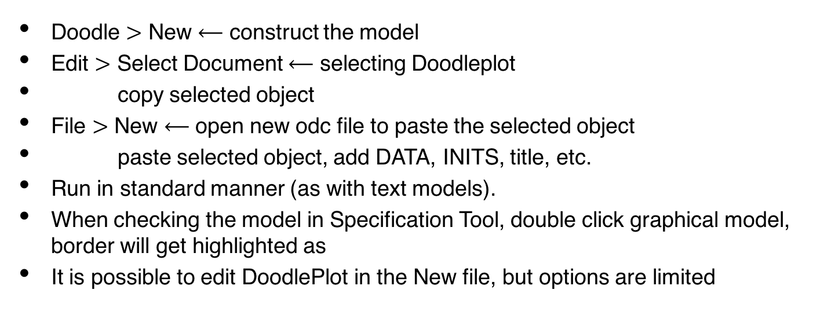
To Run Graphical Model via Doodle:
Doodle $>$ New $⟵$ construct the model
Edit $>$ Select Document $⟵$ selecting Doodleplot
copy selected object
File $>$ New $⟵$ open new odc file to paste the selected object
paste selected object, add DATA, INITS, title, etc.
Run in standard manner (as with text models).
When checking the model in Specification Tool, double click graphical model, border will get highlighted as
It is possible to edit DoodlePlot in the New file, but options are limited

Slide 4
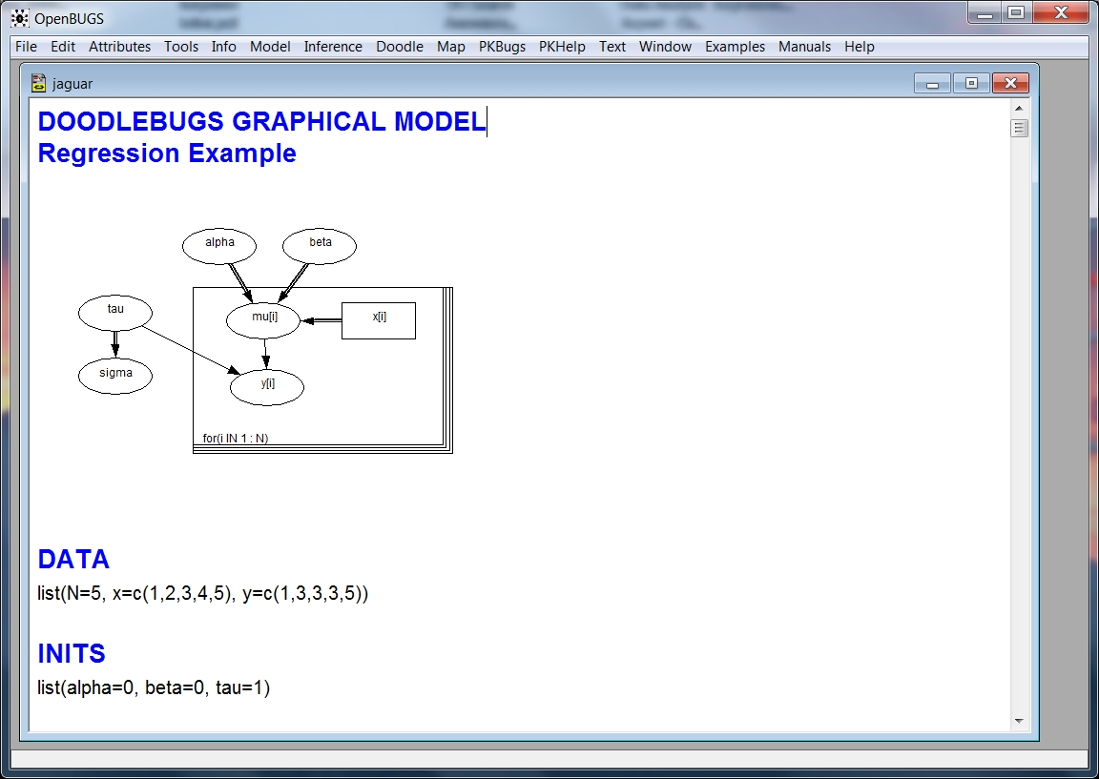
Example: Regression1.odc

Slide 5
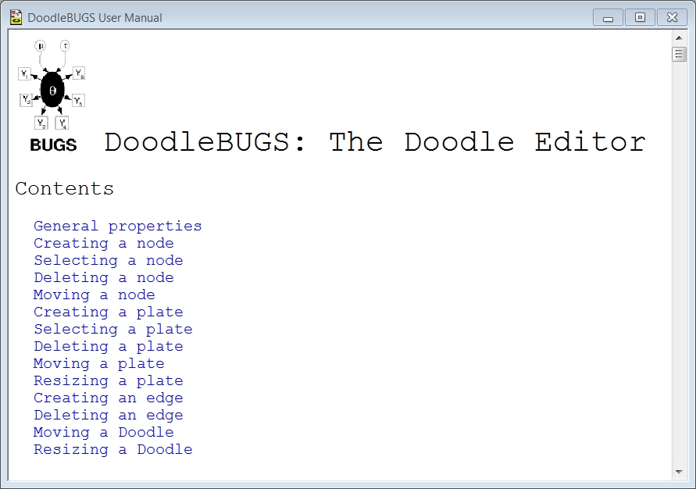
More Info:

Slide 6
Demo
Hands-on session in WinBUGS;
Creating doodleplot.

Slide 7
Summary

